Slide 1
SPATIAL DATA ANALYTICS
SQL – SPATIAL SQL

Slide 2
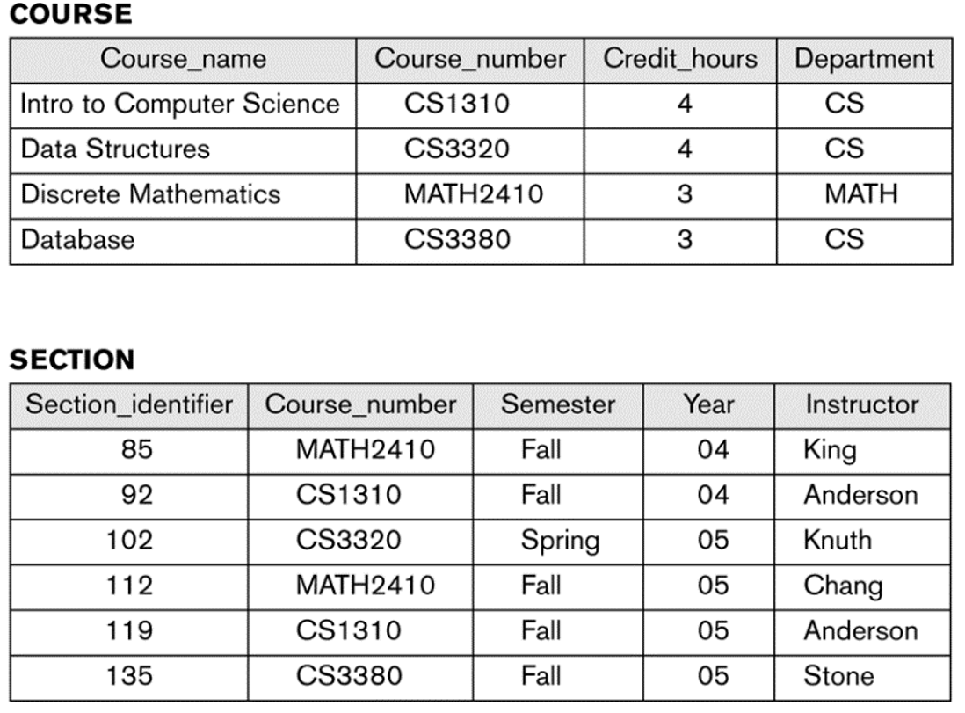
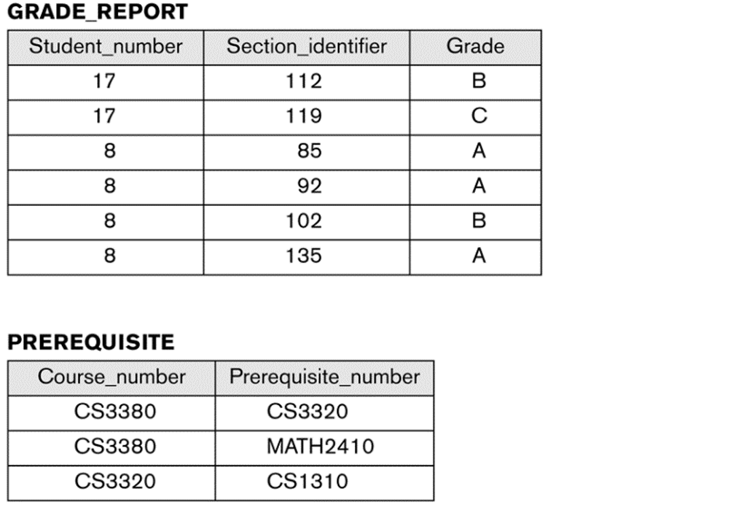
DATABASE
[1] Elmasri R Navathe S. Fundamentals of Database Systems. 5th ed. Boston: Pearson/Addison Wesley; 2007.

Slide 3
SQL STRUCTURE
SELECT <COLUMN>
FROM <TABLE>
WHERE <CONDITION>

Slide 4
www.w3schools.com/sql

Slide 5
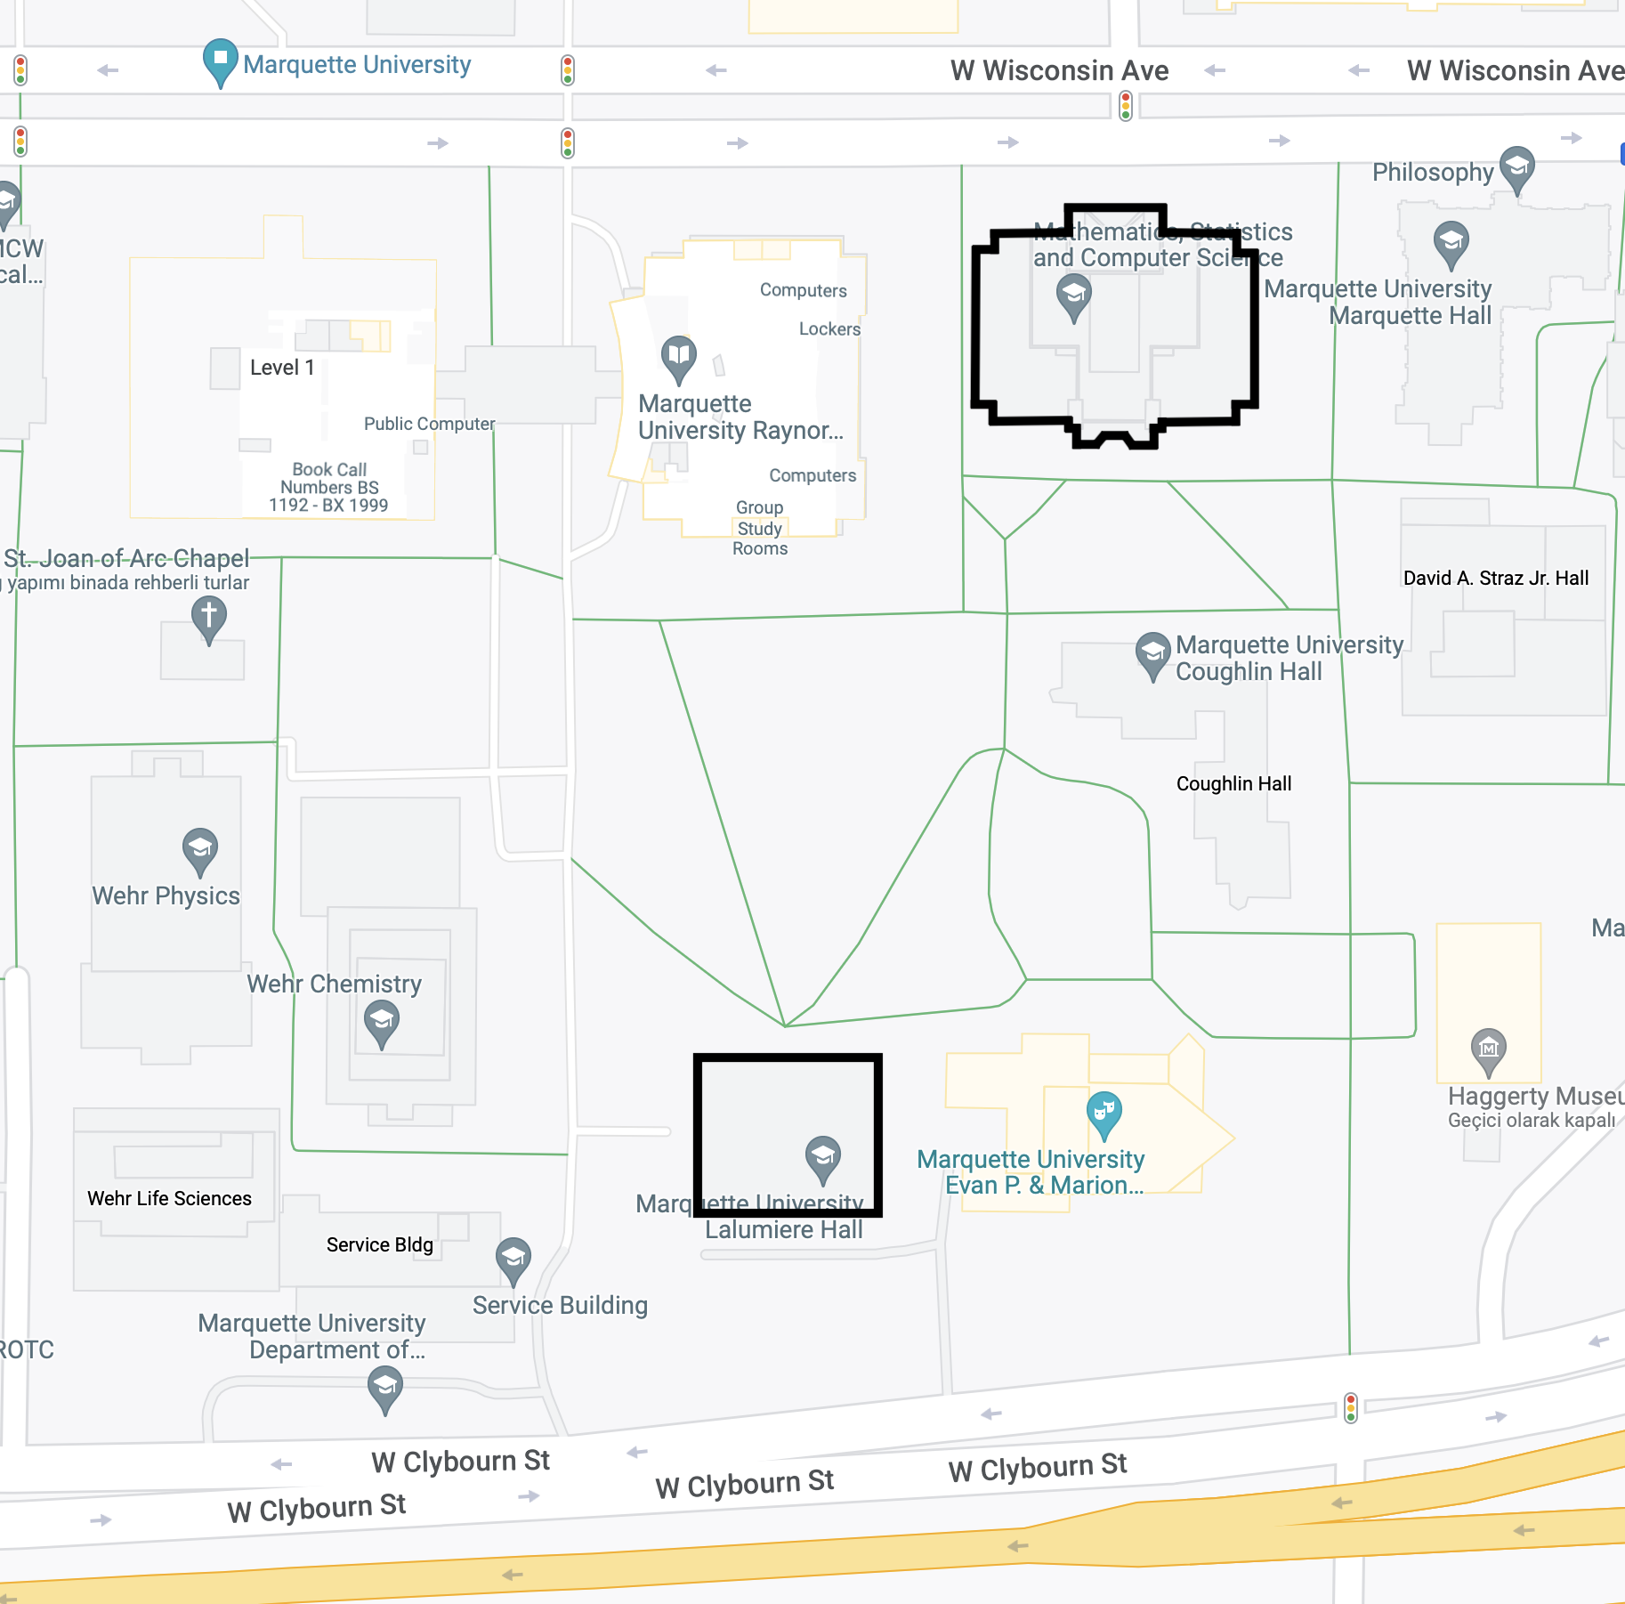
SPATIAL DATA
Lalumiere Language Hall
POLYGON(
43.0366 -87.9298,
43.0368 -87.9298,
43.0368 -87.9293,
43.0366 -87.9293,
43.0366 -87.9298)

Slide 6
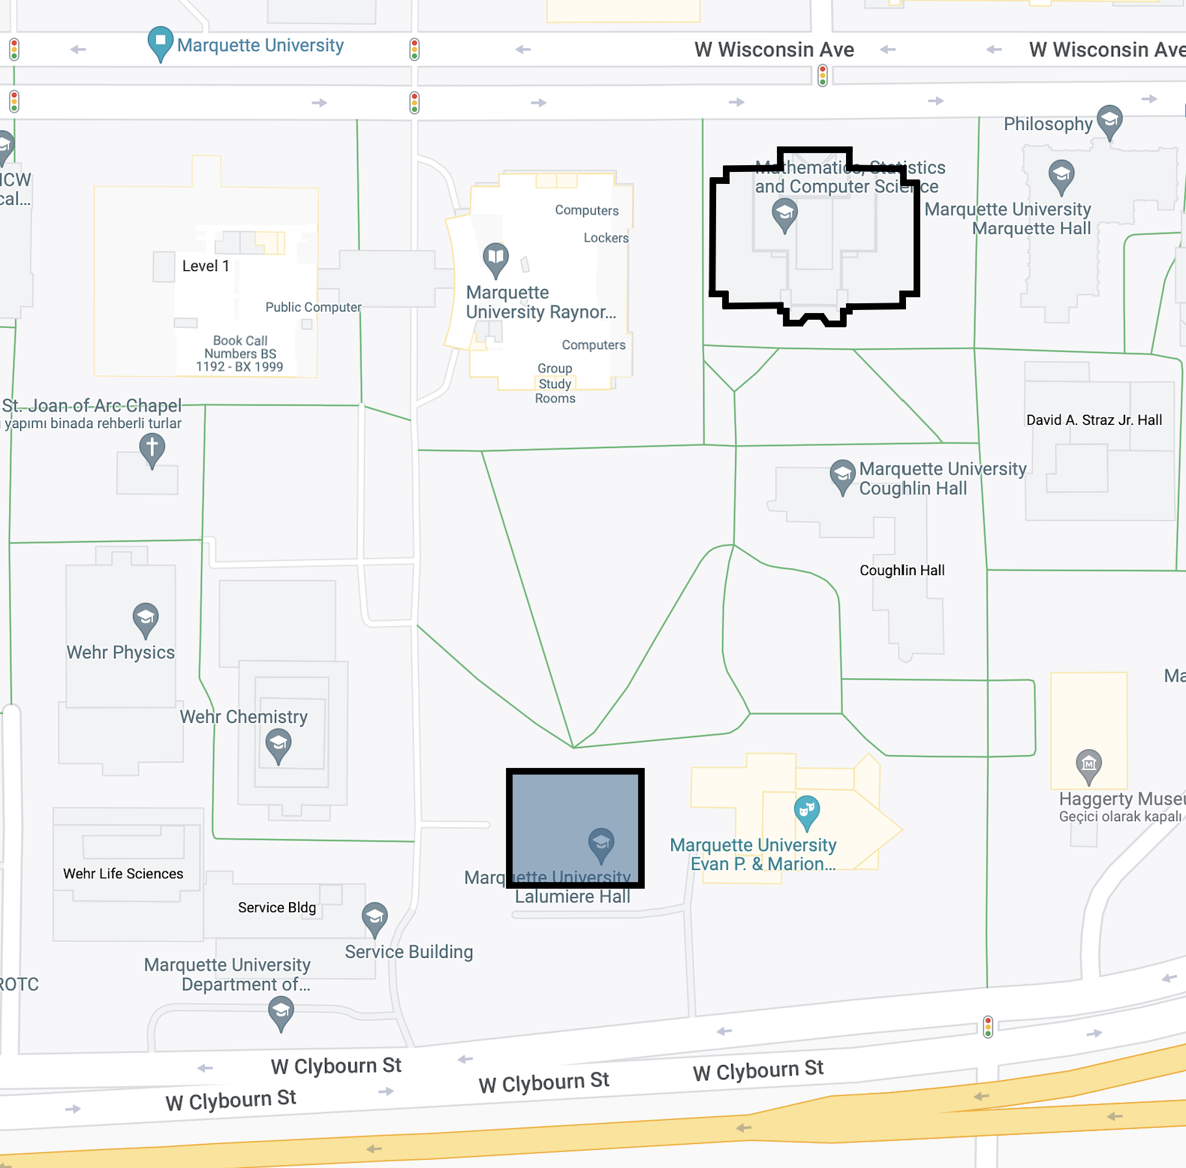
SPATIAL SQL - Area
SELECT ST_Area(geom) as area
FROM table

Slide 7
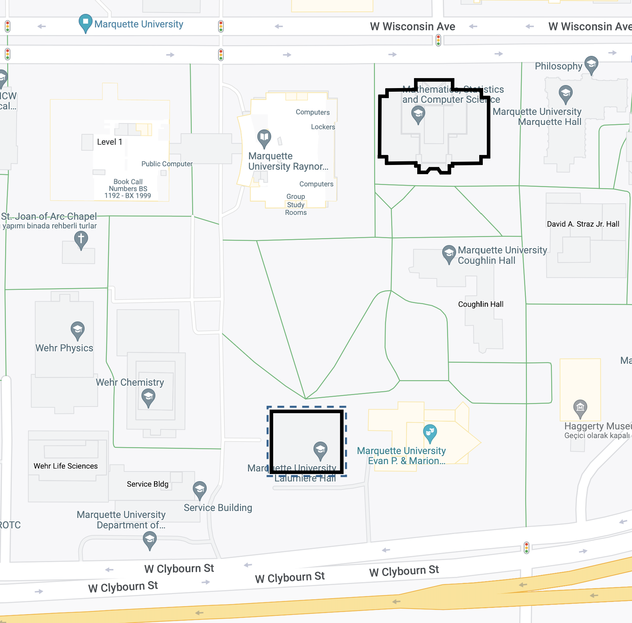
SPATIAL SQL - Perimeter
SELECT ST_Perimeter(geom) as perimeter
FROM table

Slide 8
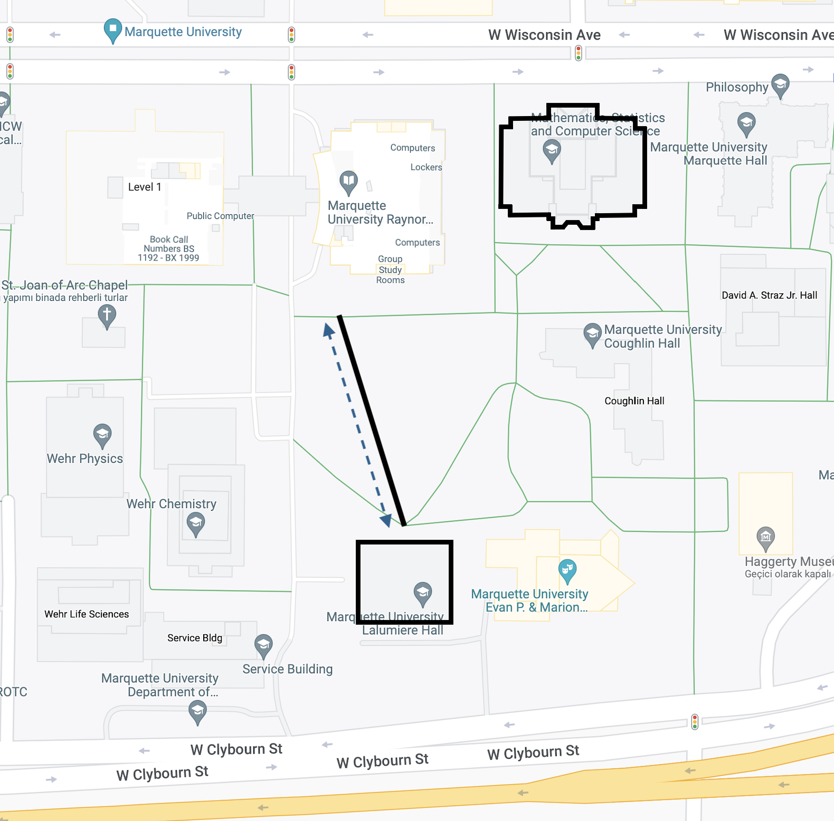
SPATIAL SQL - Length
SELECT ST_Length(geom) as length
FROM table

Slide 9
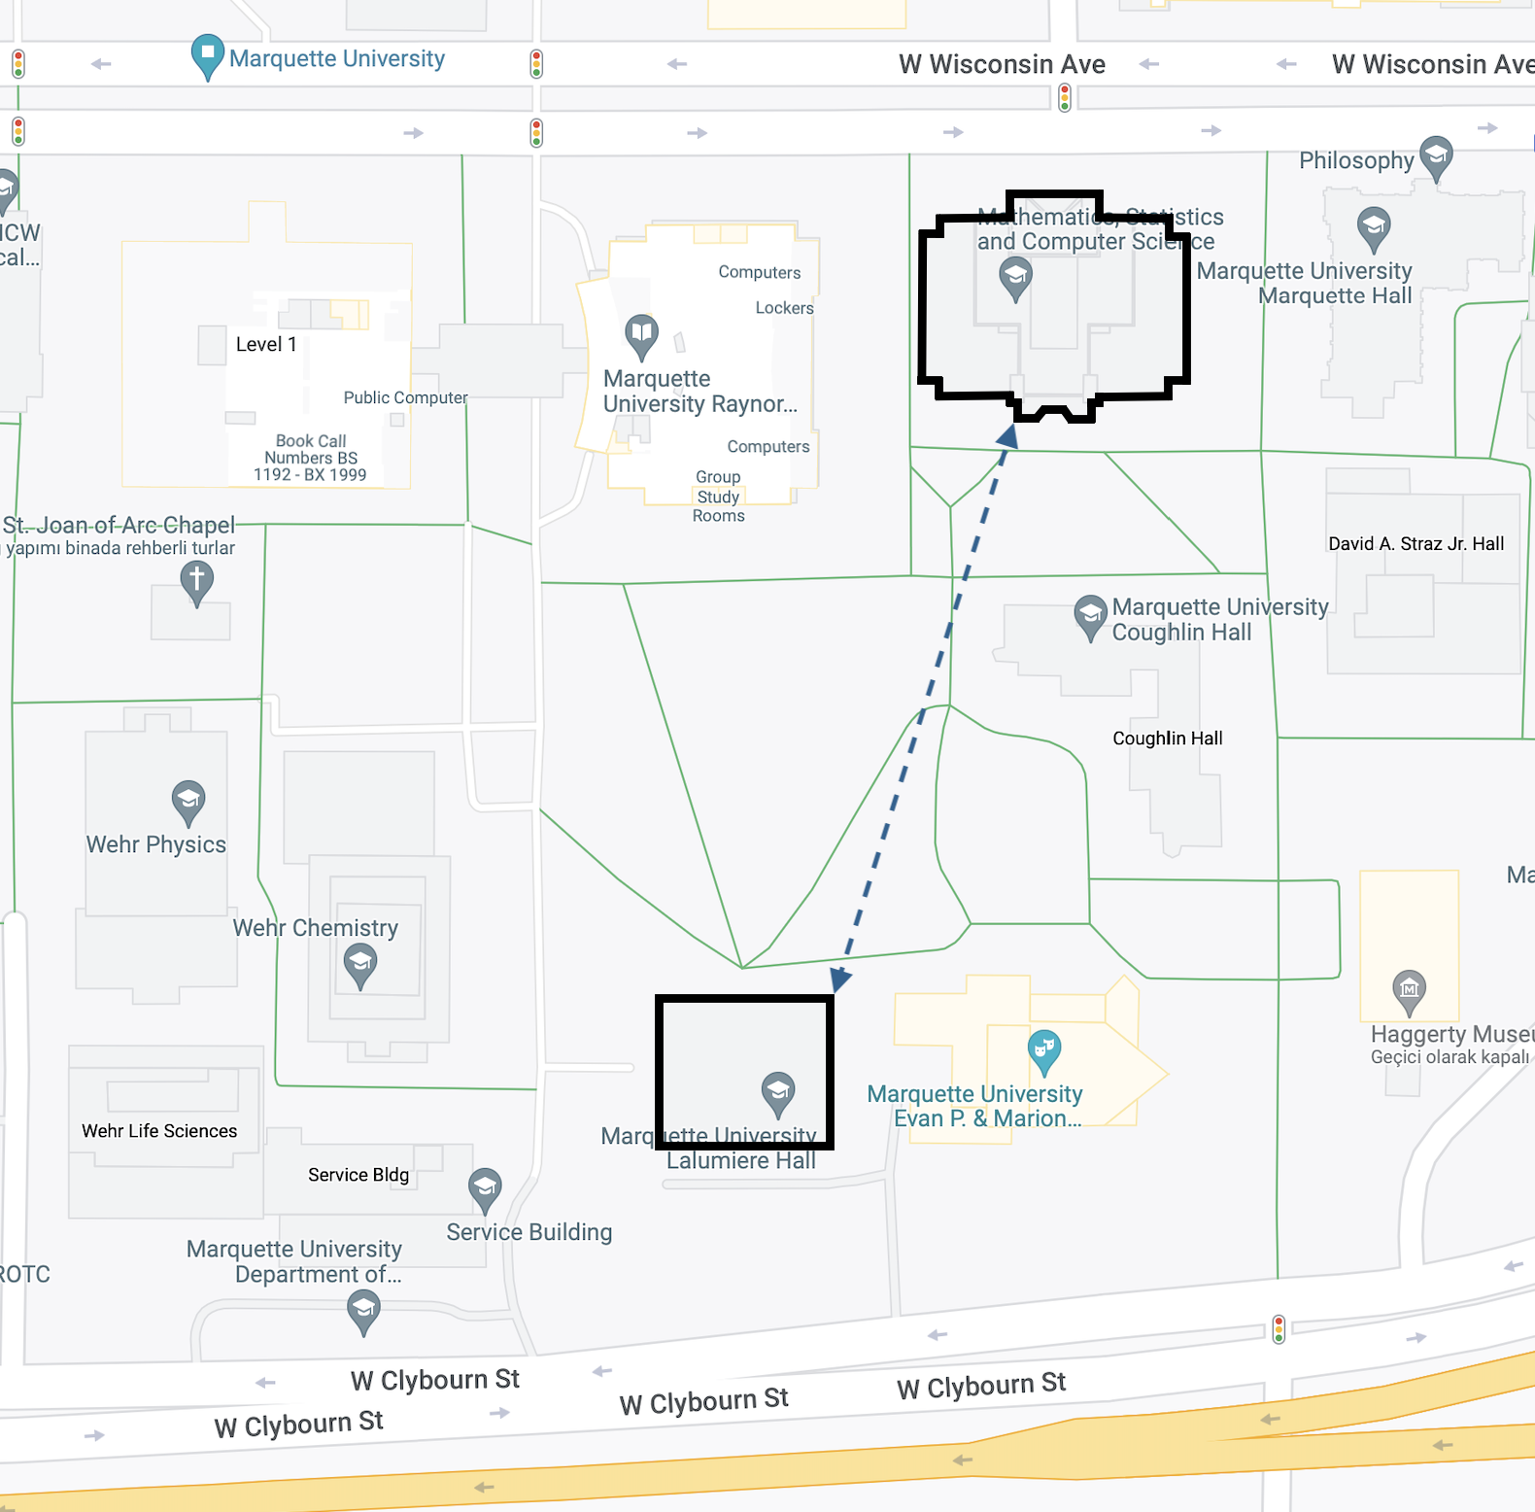
SPATIAL SQL - Distance
SELECT
ST_Distance(geom1,geom2) as distance
FROM table

Slide 10
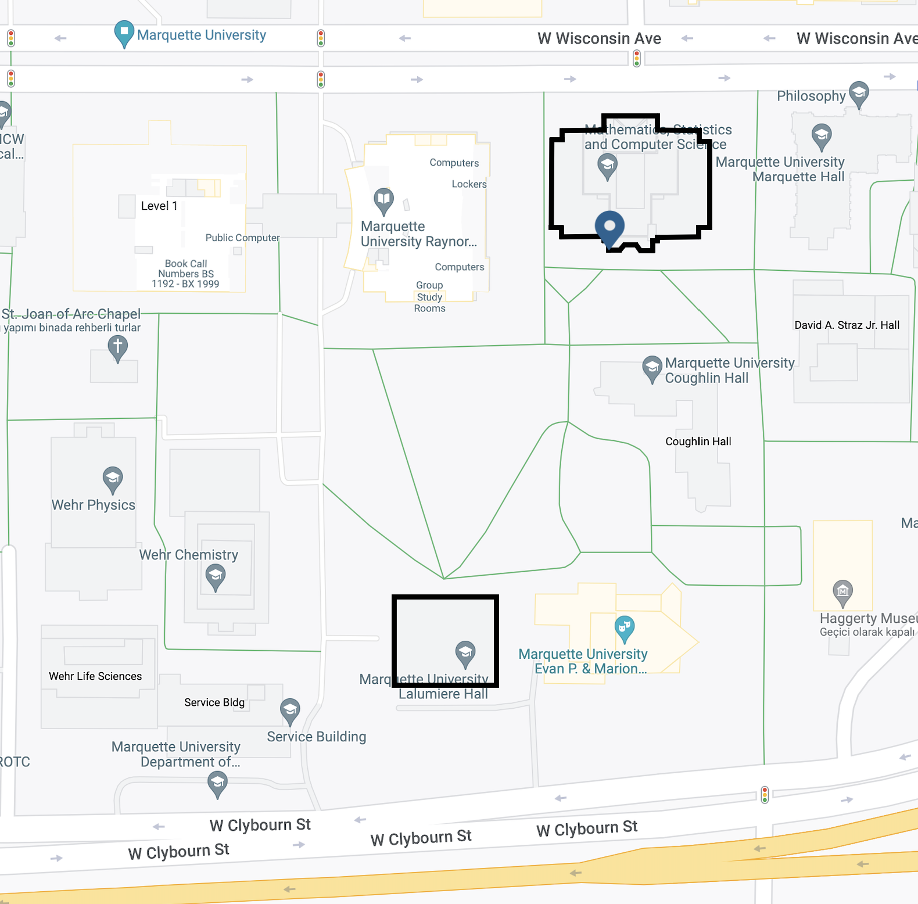
SPATIAL SQL – Closest Point
SELECT
ST_ClosestPoint (geom1,geom2) as closest_point
FROM table

Slide 11
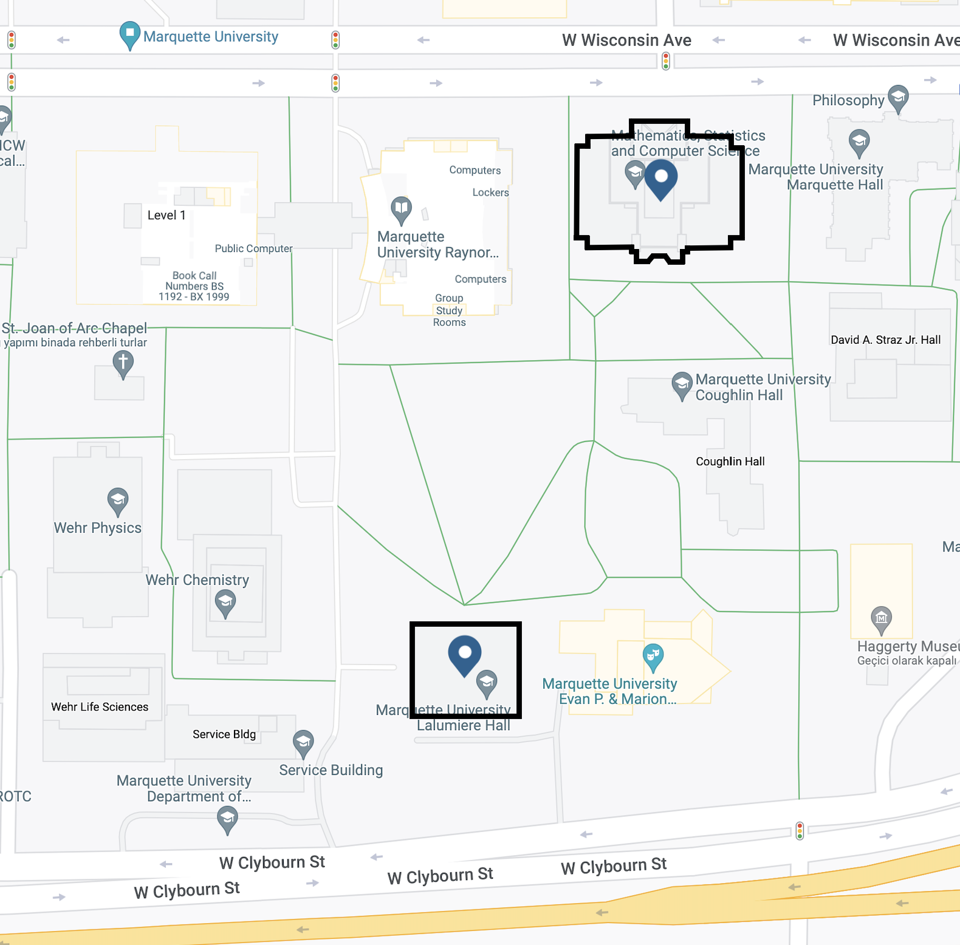
SPATIAL SQL – Centroid
SELECT ST_Centroid(geom) as centroid
FROM table

Slide 12
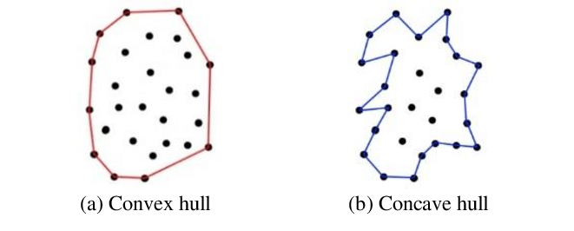
SPATIAL SQL – Concave or Convex Hull
SELECT
ST_ConcaveHull (geom) as concave_hull
FROM table
SELECT
ST_ConvexHull (geom) as convex_hull
FROM table
[2] Yahya. Assoc Prof Ts. Dr, Zahrah & Wirza, Rahmita & Fatimah, K. & Rizaan, Amir & Rizal, Ahmad. (2015). A Concave Hull Based Algorithm for Object Shape Reconstruction.
International Journal of Information Technology and Computer Science. 09. 1-3. 10.5815/ijitcs.2017.03.01.

Slide 13
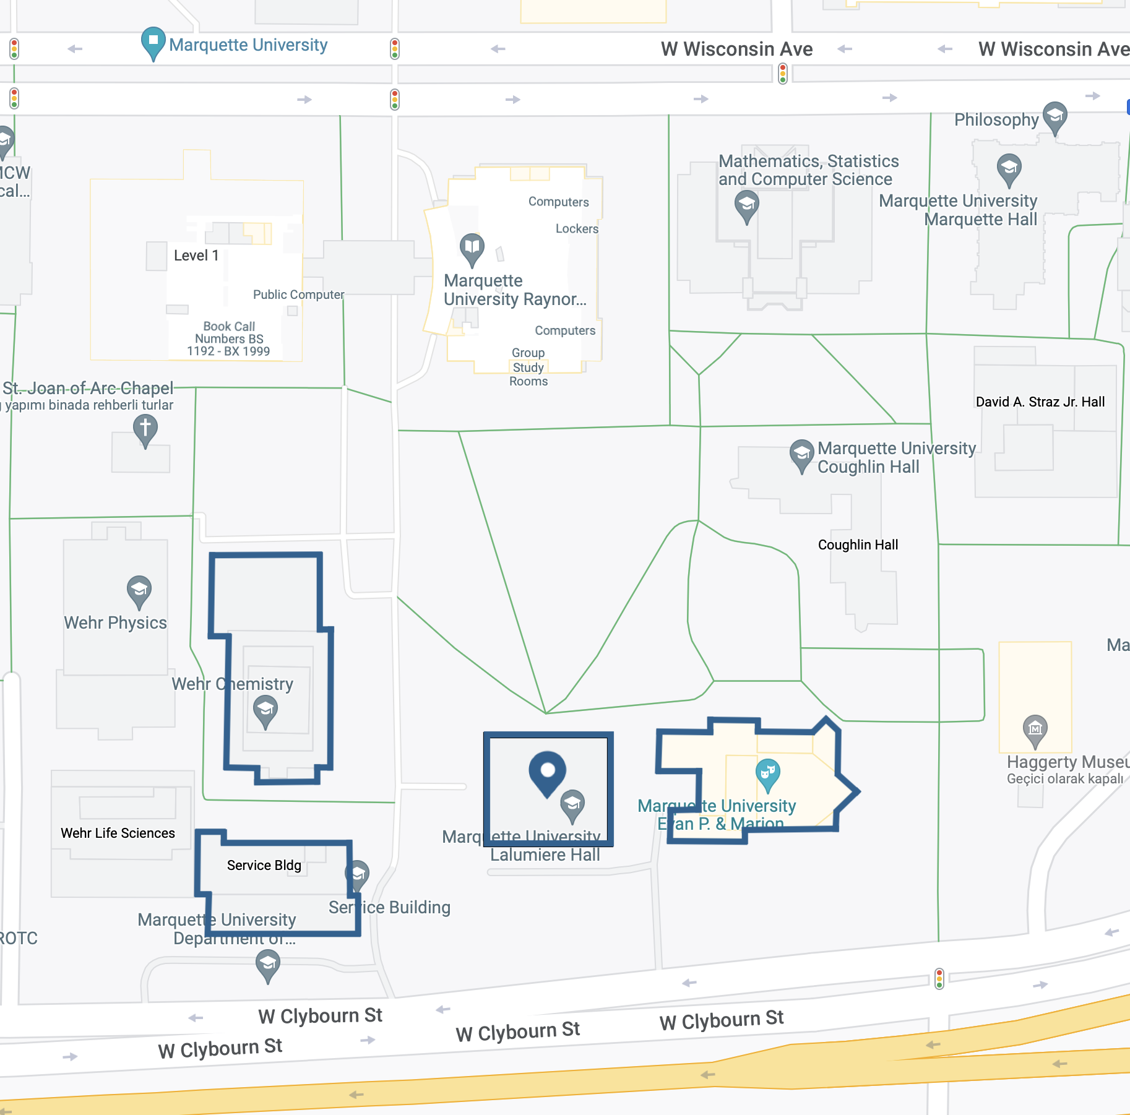
SPATIAL SQL – Geometries Within a Distance
SELECT geom
FROM table
WHERE ST_DWithin(geom,
ST_GeomFromText('POINT(43.0367, -87.9294)'),
20)

